Slide 1
ERROR STACK DTP
Milind Parab

Slide 2
Pre-Requisites for the Demo.
Load Master Data.
Create Flat File Transaction Data.
Create Info Objects.
SMID : SIDxx
PID: PIDxx
Quantity: QTY_xx
Sales: SREV_xx
Profit: PR_xx

Slide 3
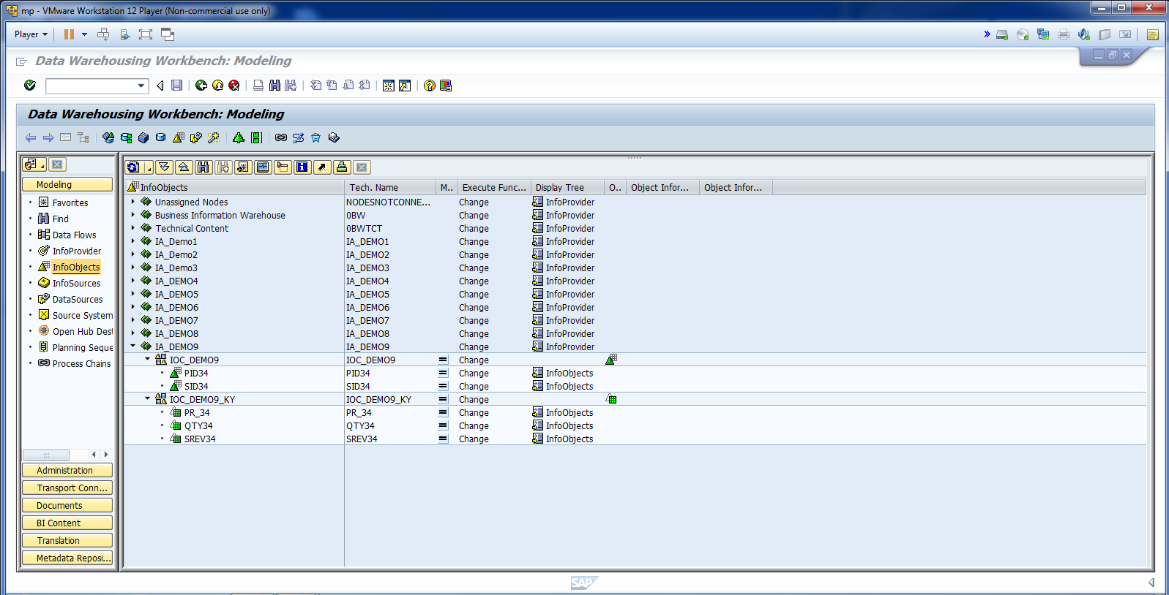
Pre-Requisites for Demo 10.

Slide 4
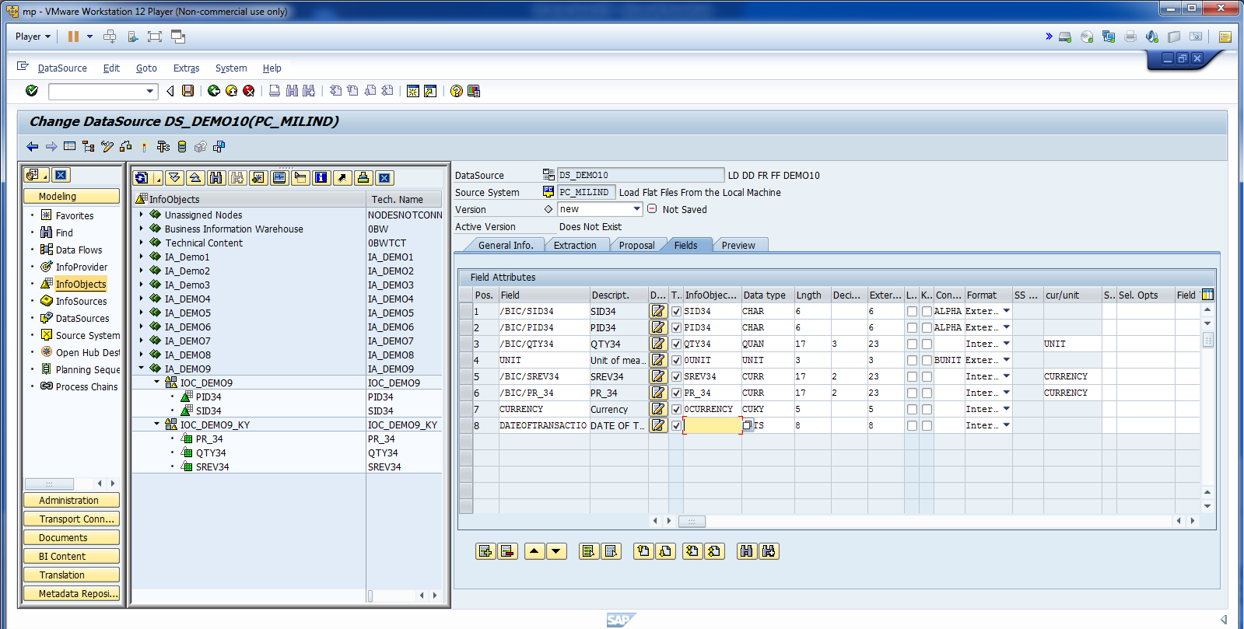
Create Data Source and Update Info.

Slide 5
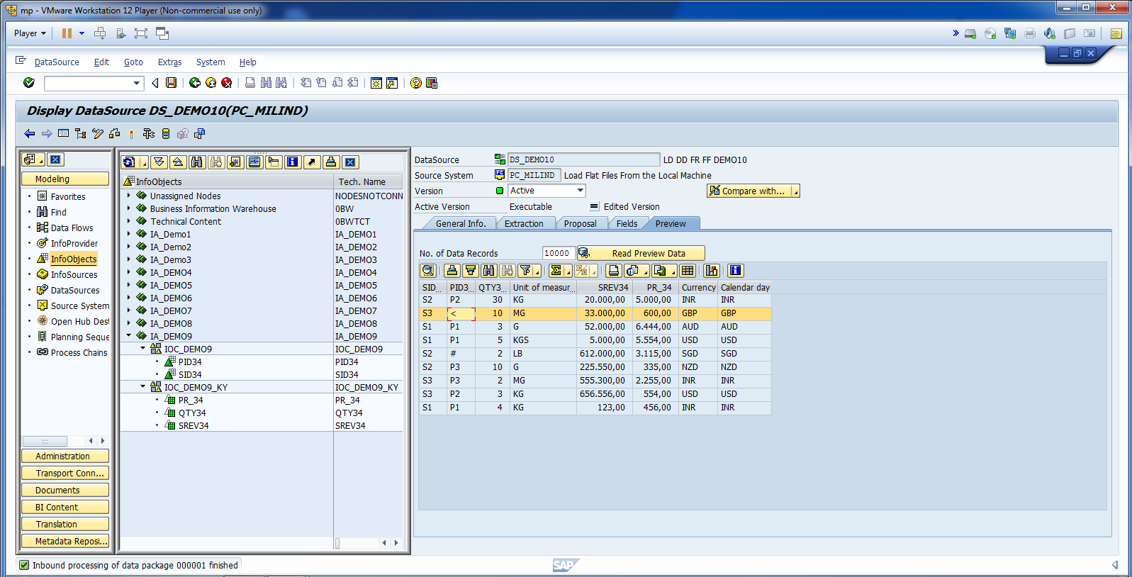
There are some illegal values in PID column.

Slide 6
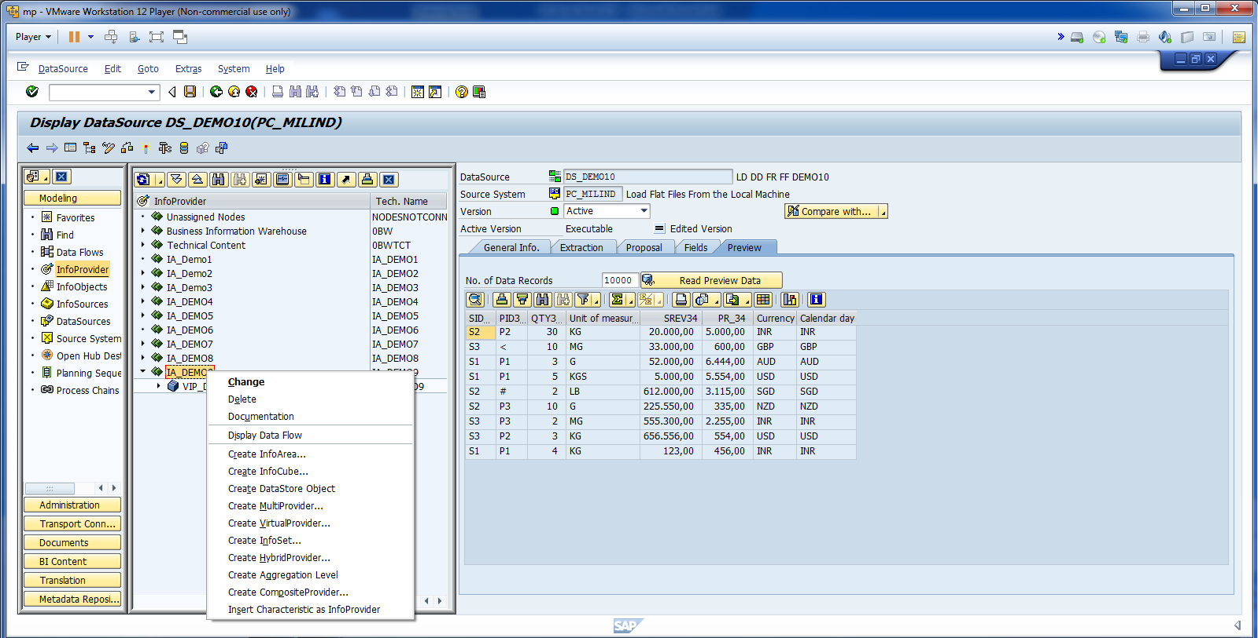
Create Standard Info Cube.

Slide 7
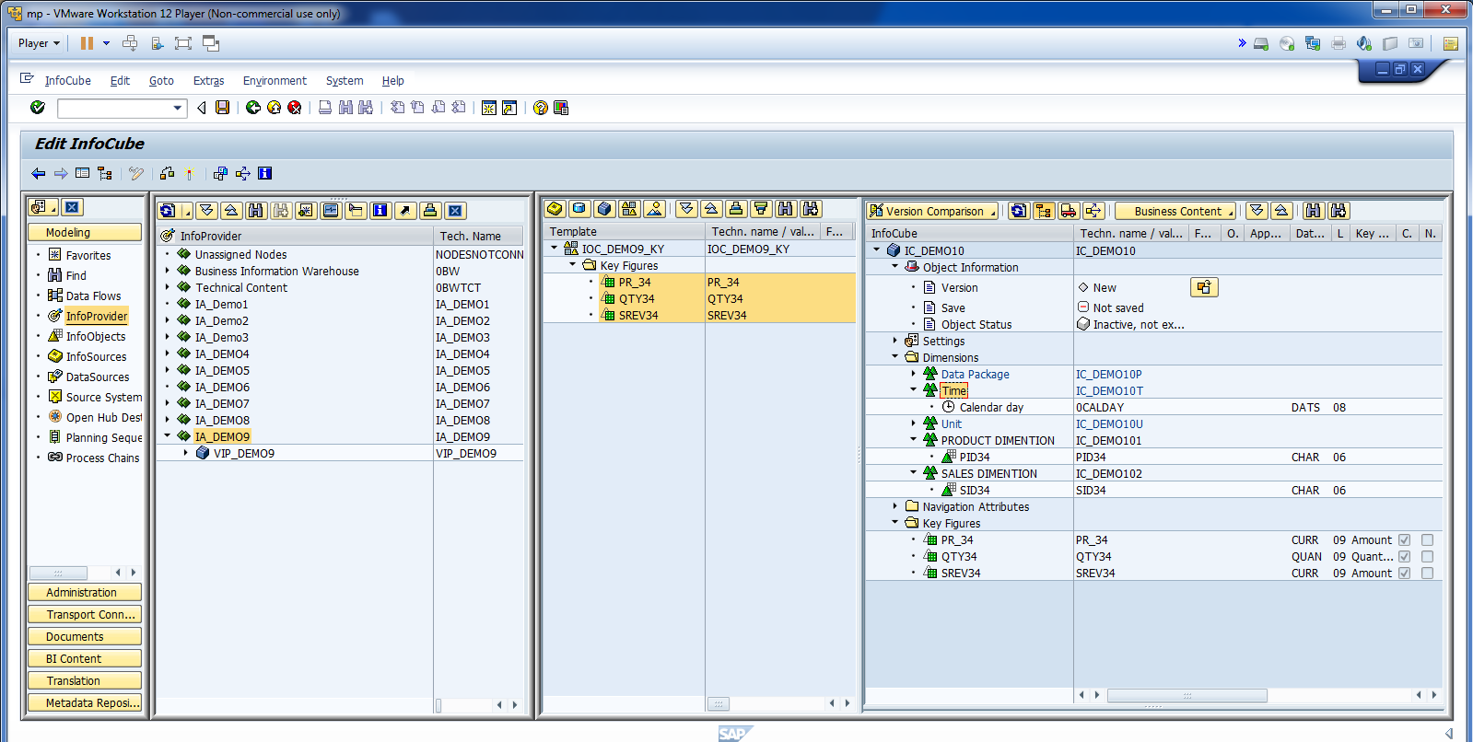
Update the info as shown below.

Slide 8
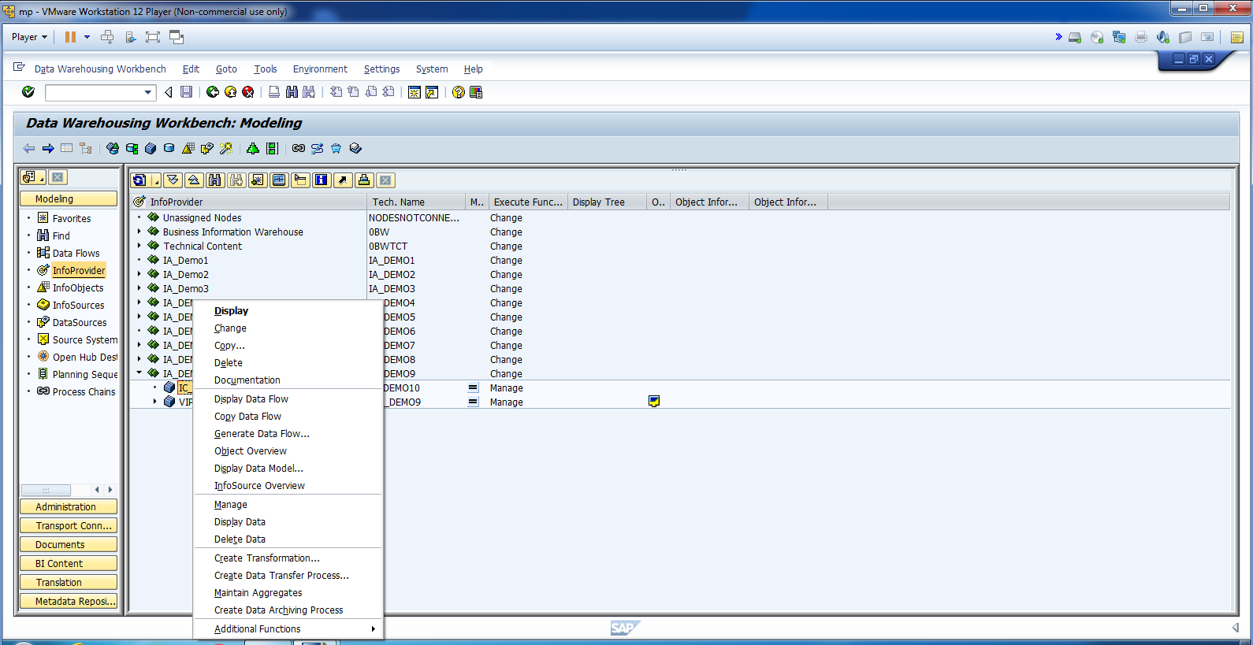
Create Transformation.

Slide 9
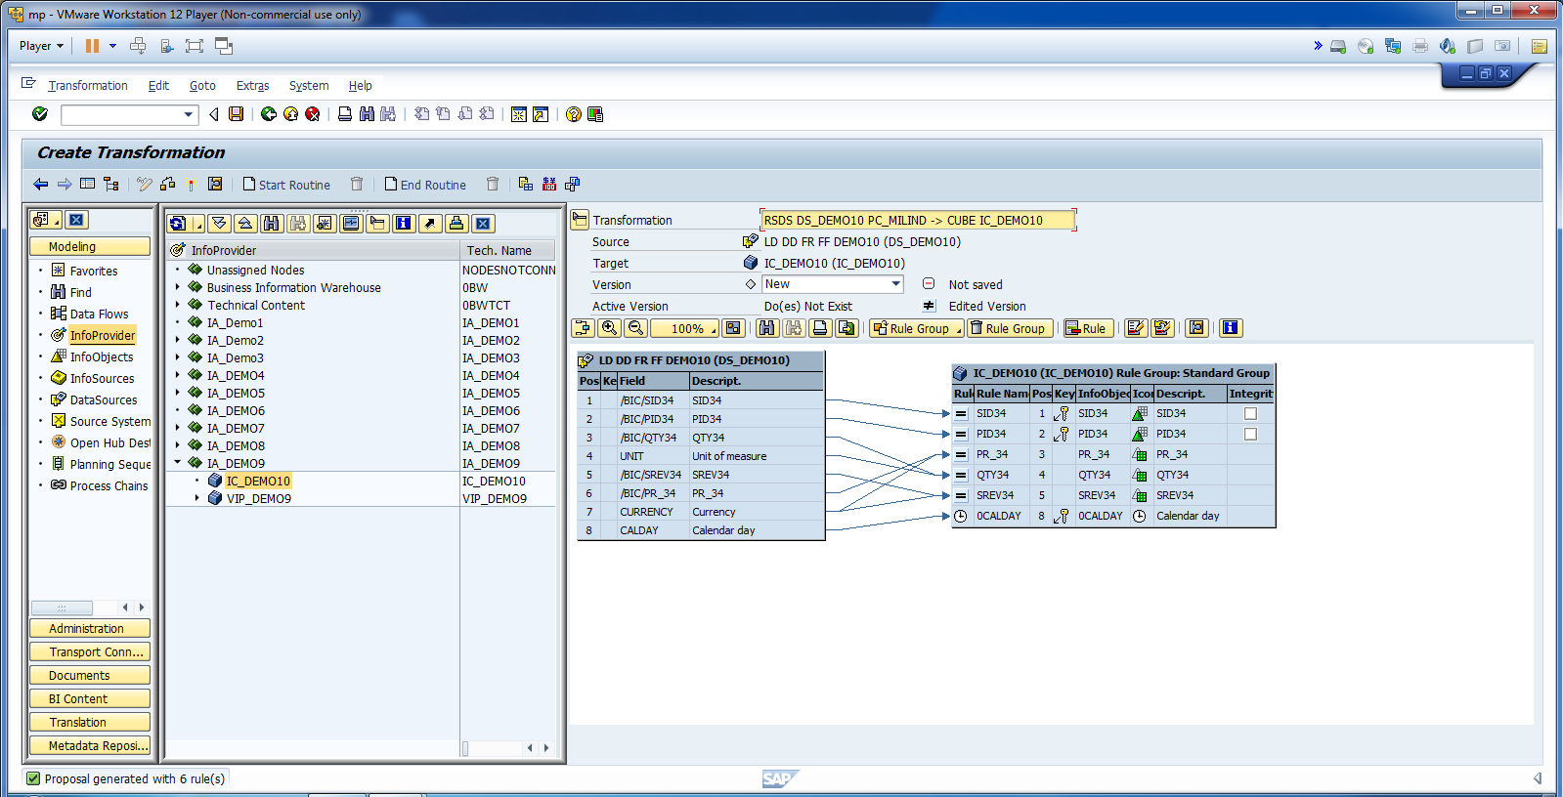
Map all fields.

Slide 10
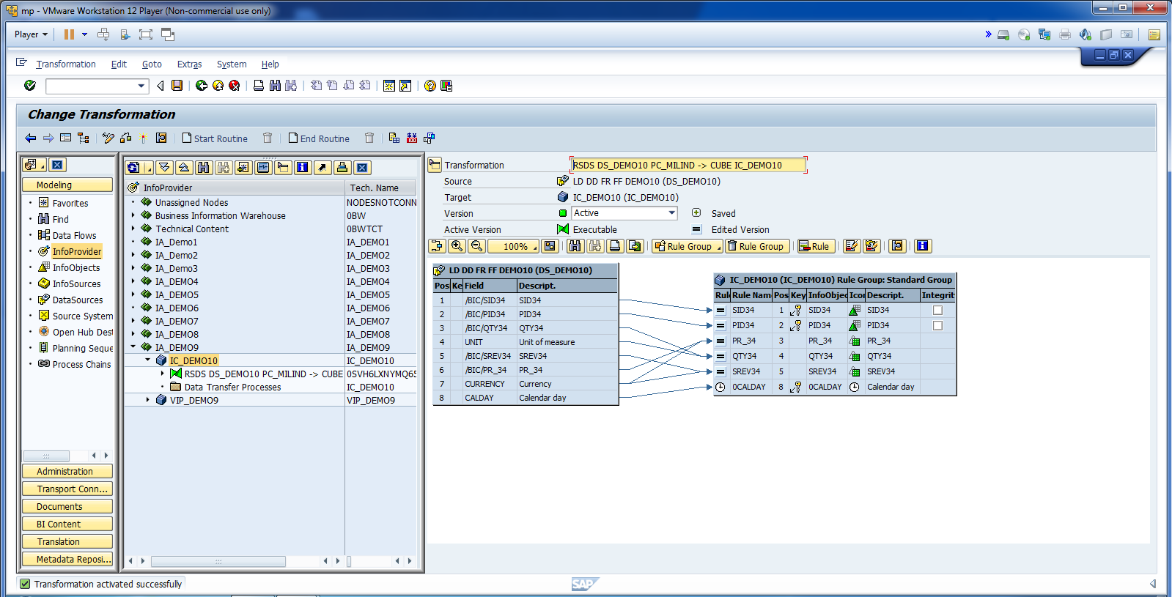
Activate Info Cube.

Slide 11
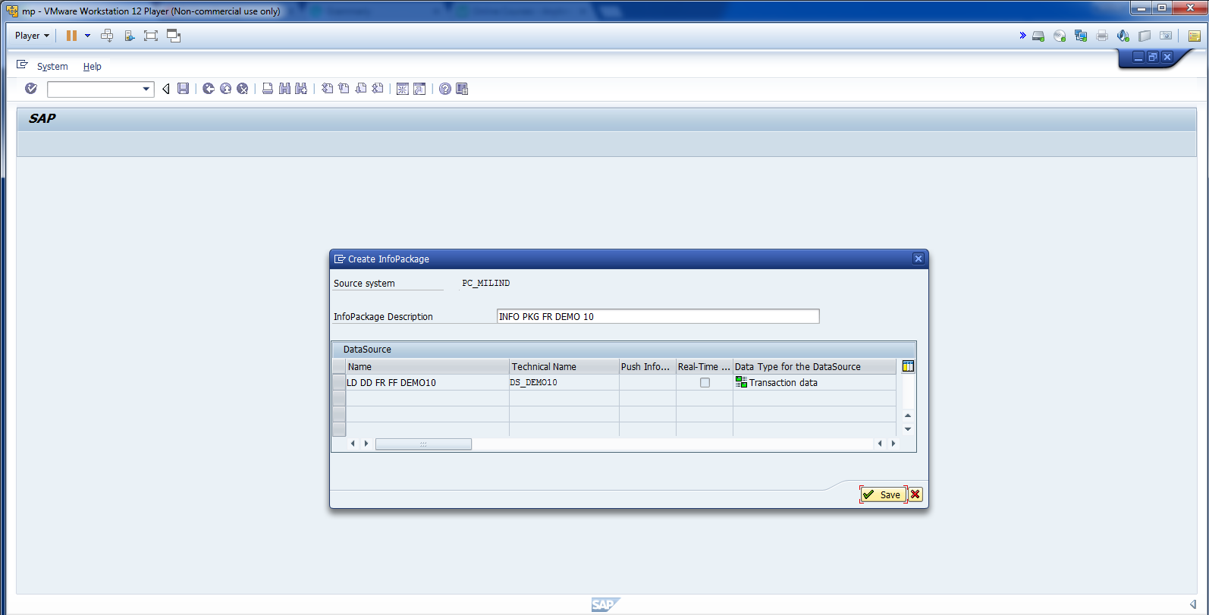
Create Info Package.

Slide 12
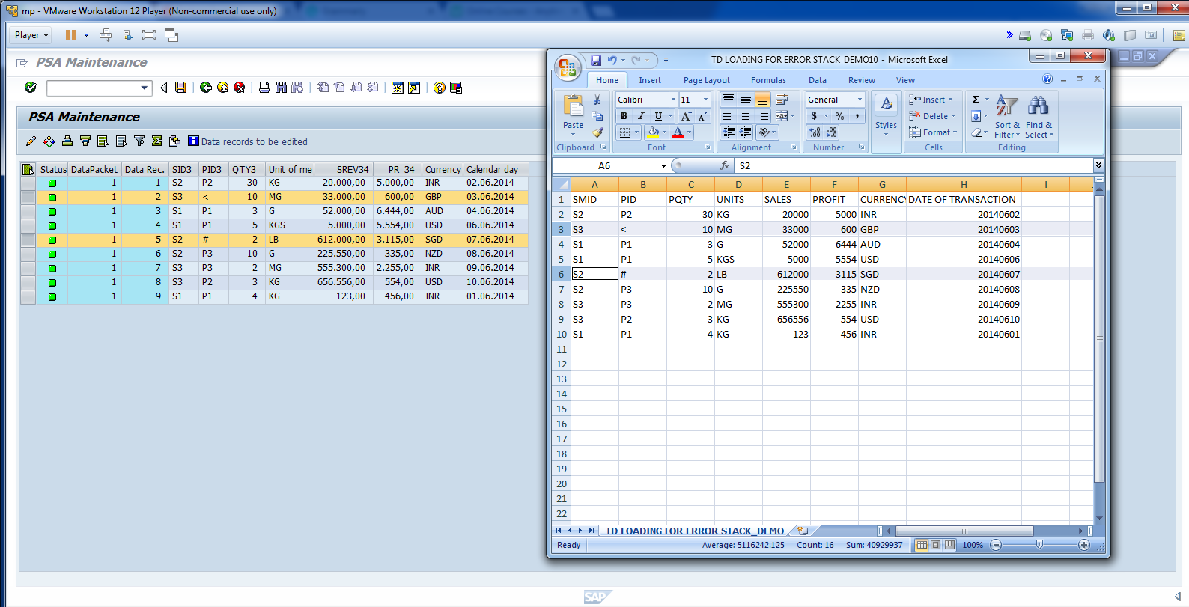
Monitor the data in PSA.

Slide 13
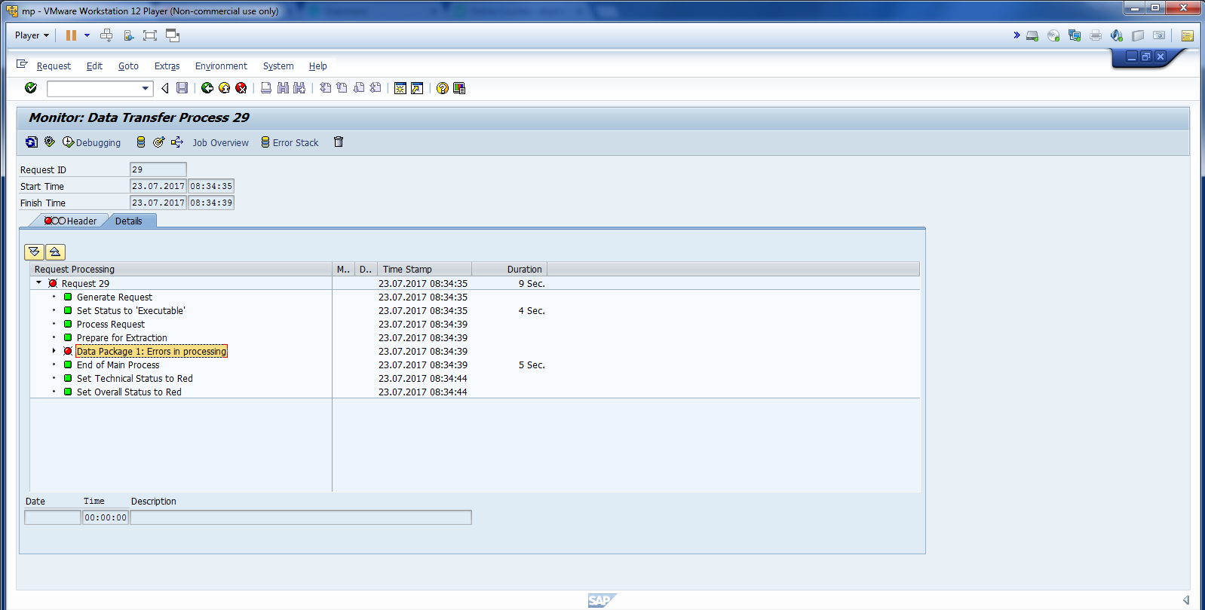
Cont.

Slide 14
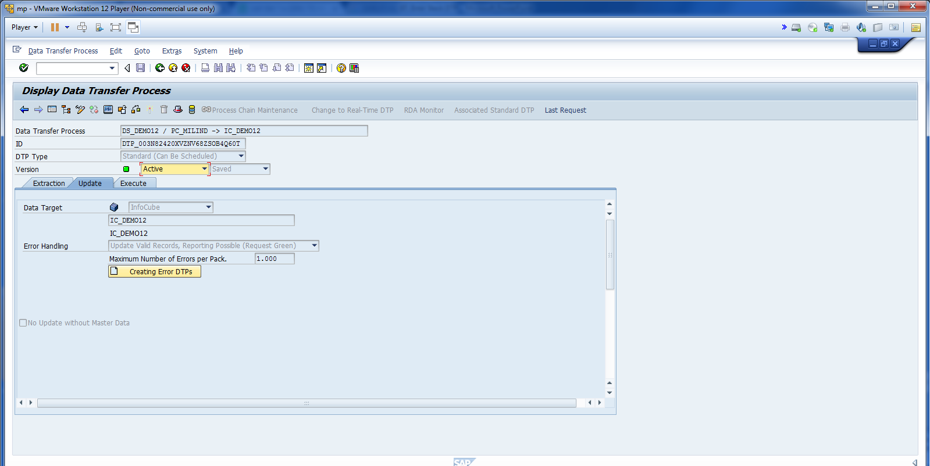
Change update to update valid records.

Slide 15
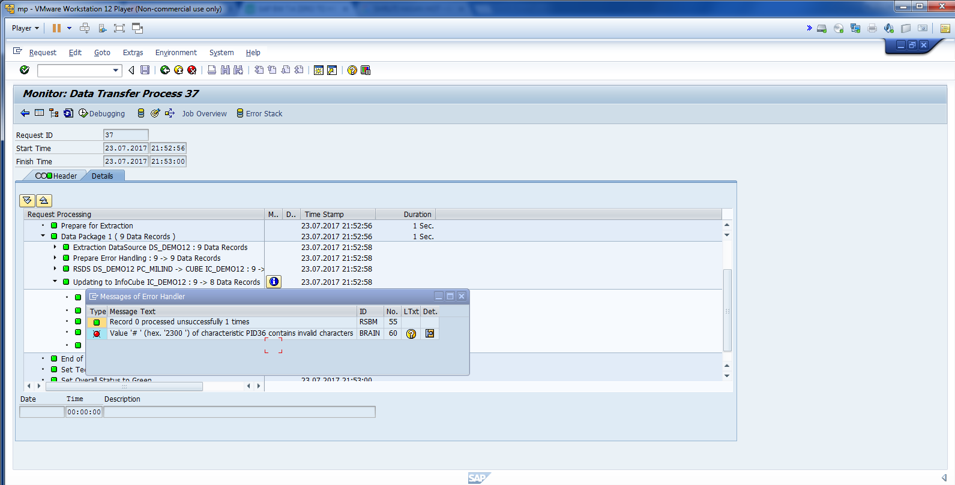
Error Message.

Slide 16
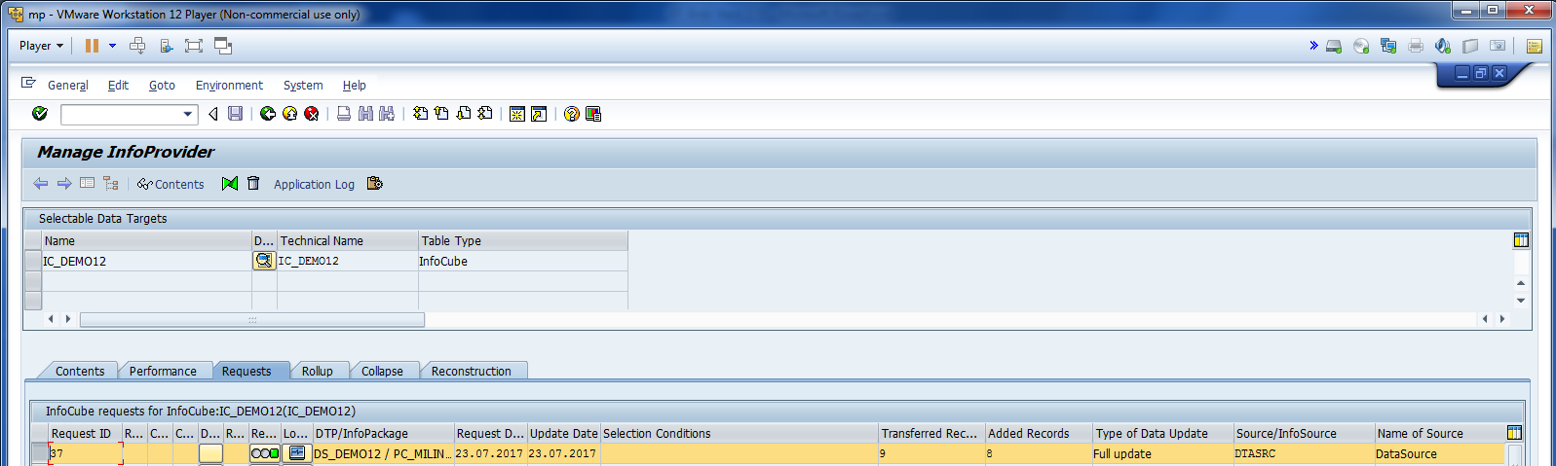
Transferred records 9 and added only 8.

Slide 17
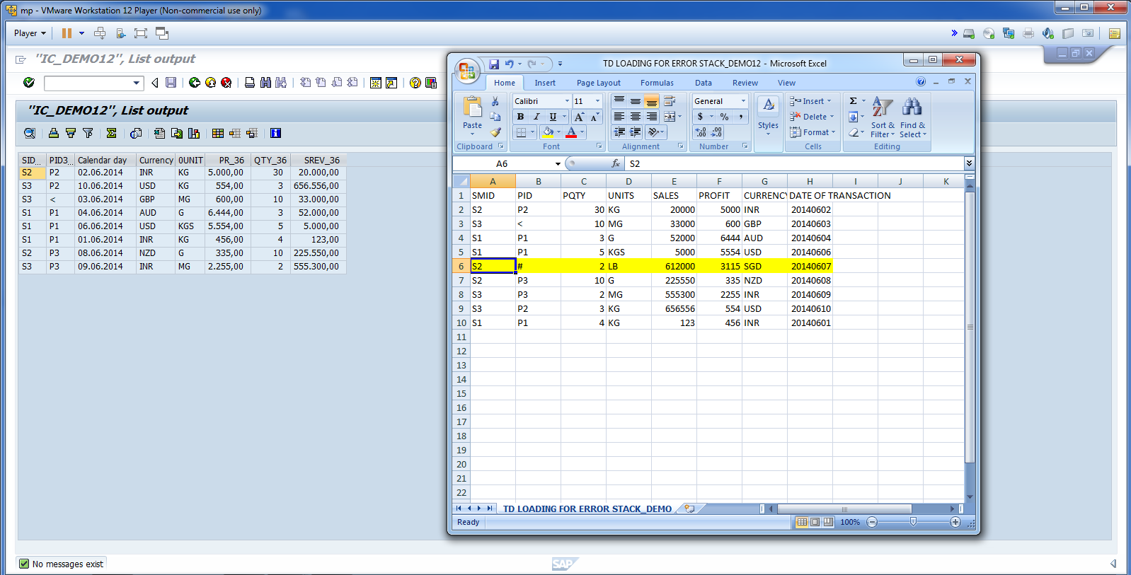
FF data and Data in InfoCube. (Only 8 records)

Slide 18
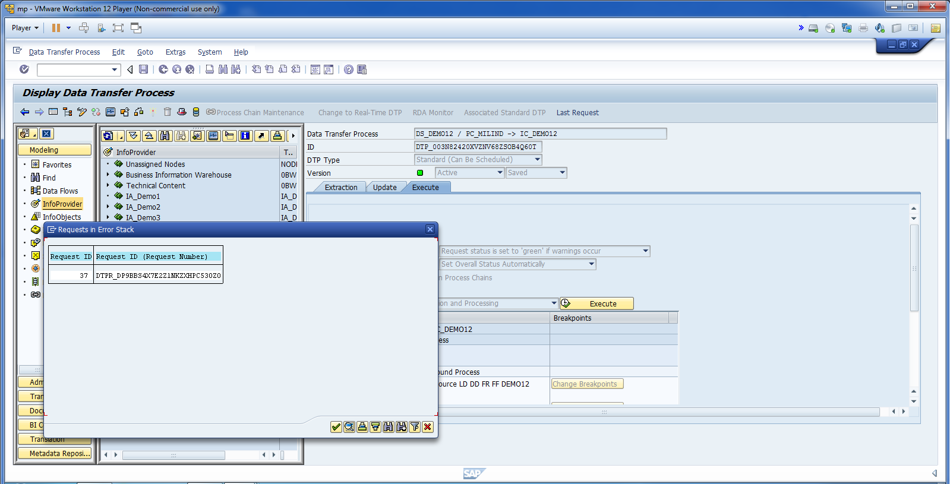
Double click on DS. Click on display Error Stack.

Slide 19
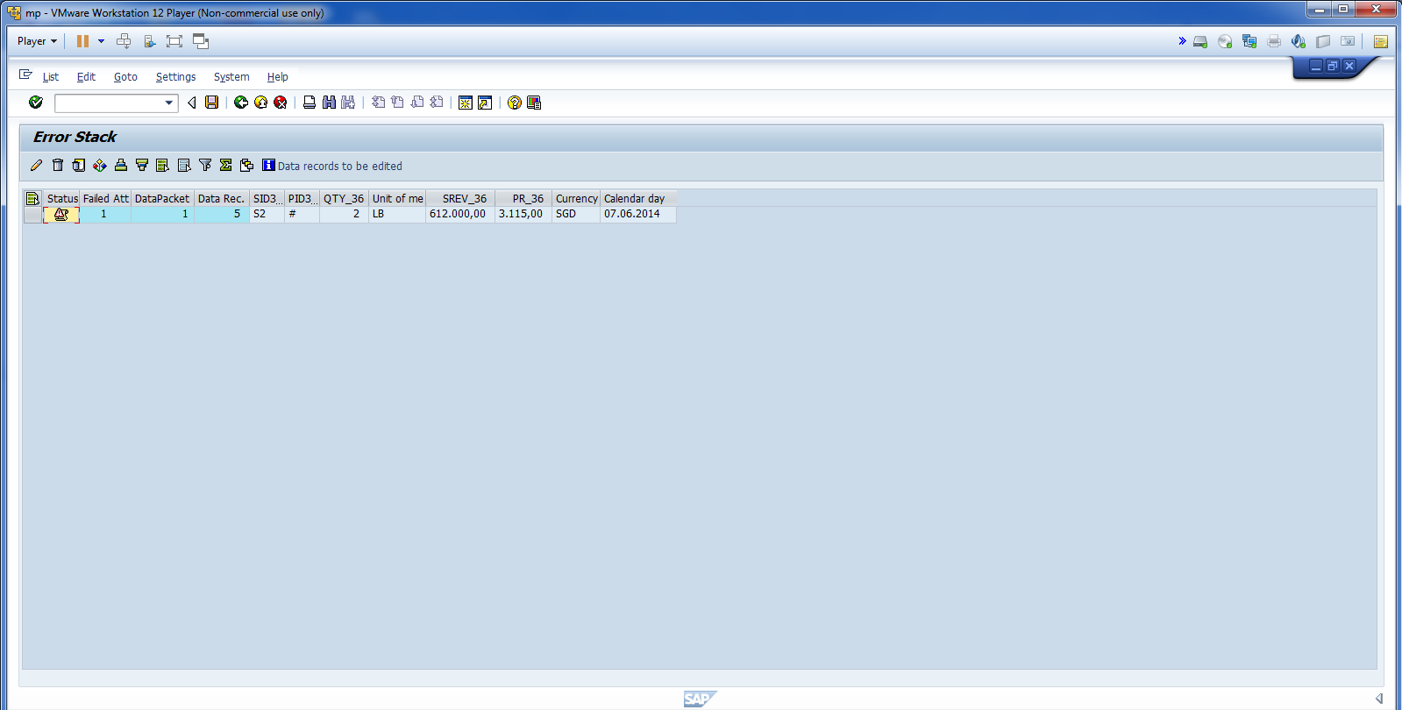
Error Record.

Slide 20
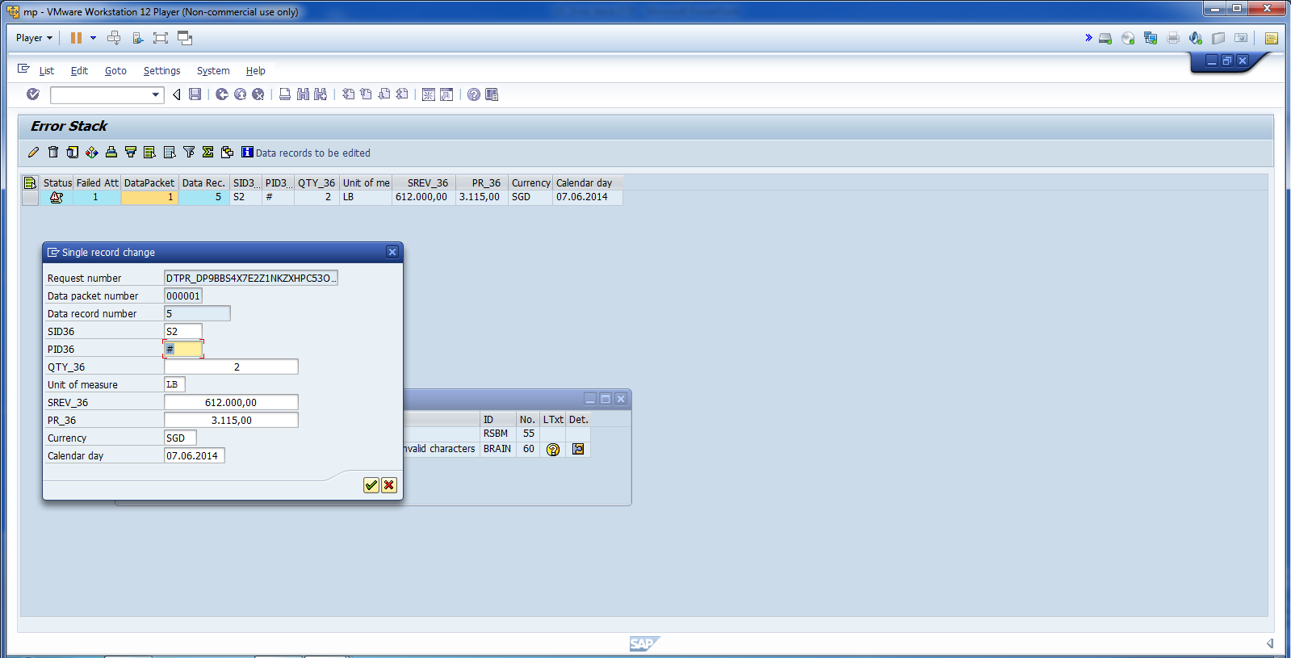
Fix Error and save the data.

Slide 21
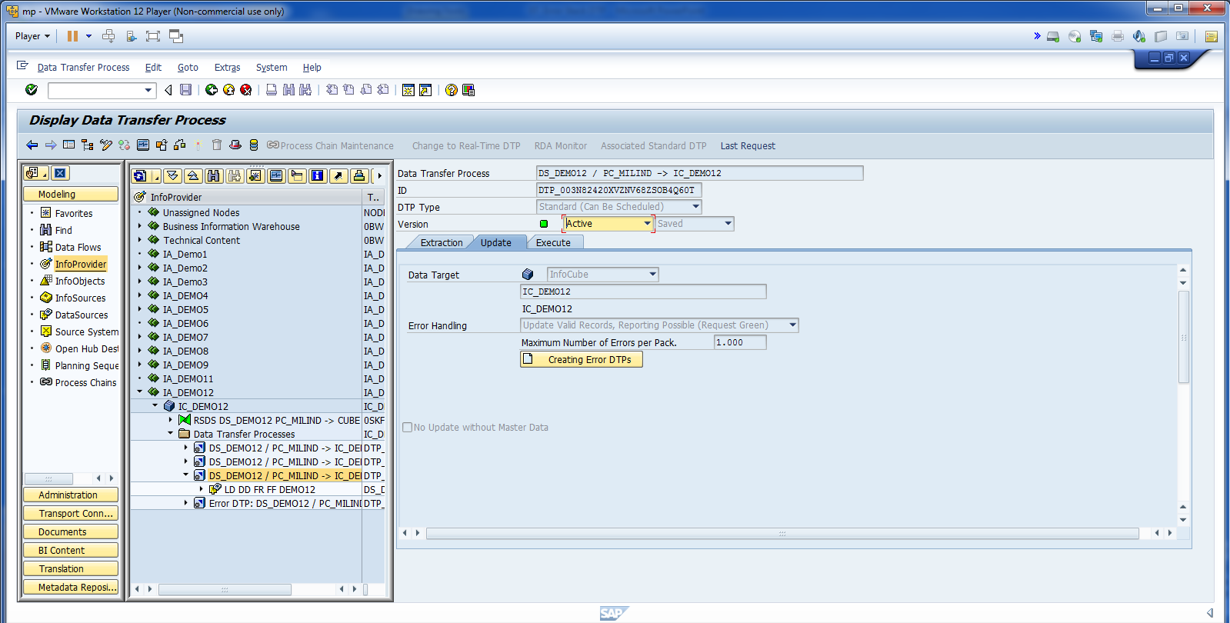
Click on Creating Error DTP.

Slide 22
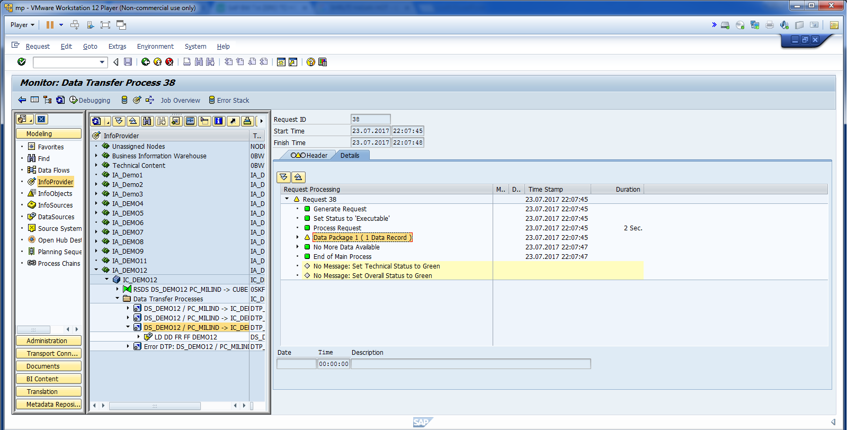
Only One Records has been loaded.

Slide 23
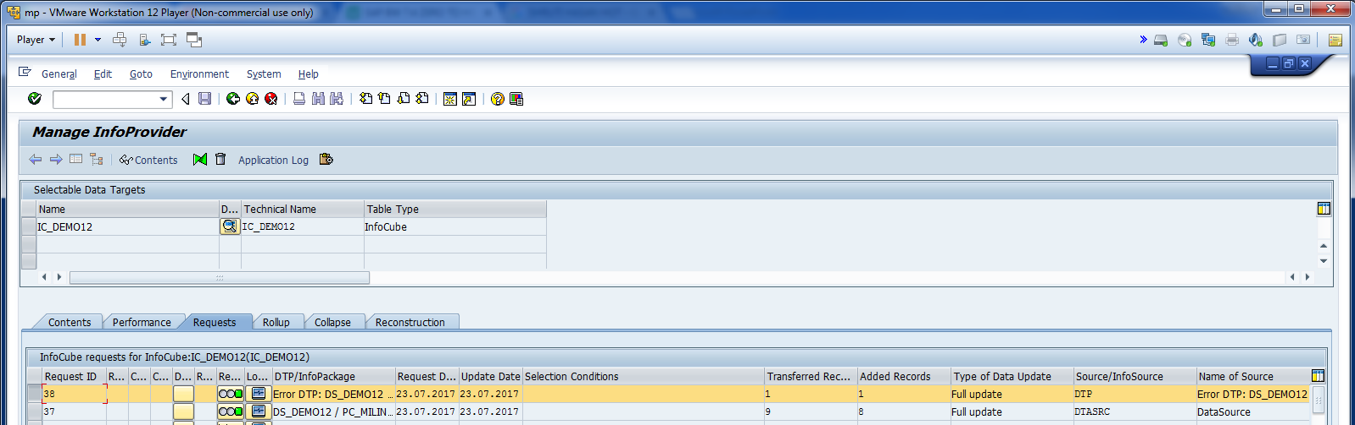
Cont.

Slide 24
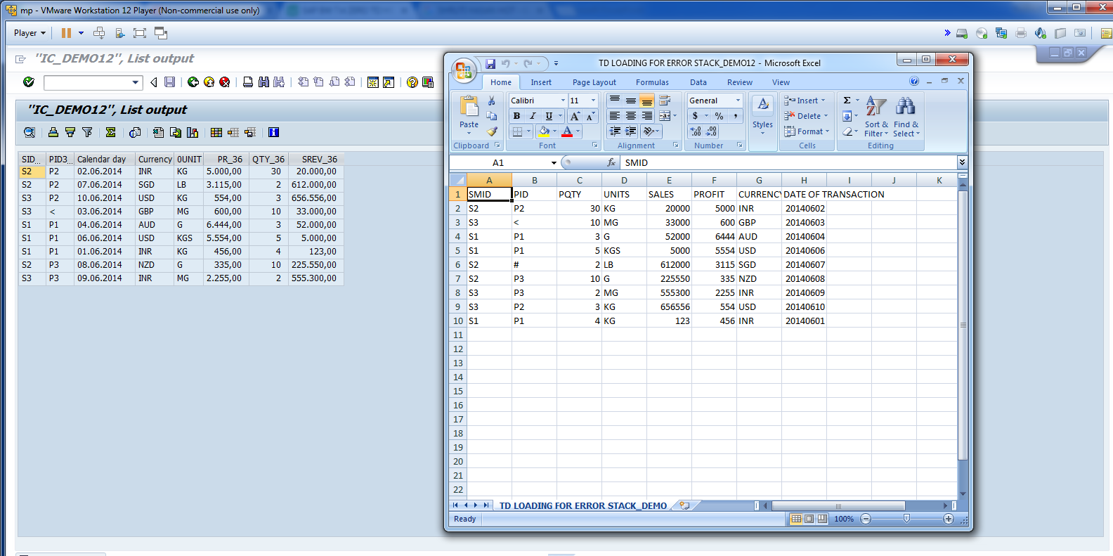
All 9 Records loaded successfully.

